Slide 1


Slide 2
SMART GLOVE
Jazib Ahmed ECI-IT-15-051 Akash Jamil ECI-IT-15-037
M.Usama Riaz ECI-IT-15-078
Tehniyyat Jamil ECI-IT-15-081
Engr. Kamran Khan
Engr. Aqeel Anwar

Slide 3
Problem Statement
In the recent years, due to birth defects, accidents and oral diseases, there has been a rapid increase in the number of disabled persons including the speech disabled/hearing impaired.
These things made the patients completely or partially dependent upon others.
To mitigate the enslavement of such persons, a system was required that could enable these persons to perform some basic tasks by themselves.

Slide 4
Aims & Objectives
The main aim of the project was to develop a reliable, easy to use, light weight smart hand gloves system which could abate the snags for disabled people so that they may stand with the race.
To develop a portable glove that could recognize gestures and Determine the position of hand.
Control five different appliances by gestures in relax position of hand.
Send five different messages of need in the lifted position of hand.
To display the information on LCD about switching of load and messages being sent.

Slide 5
Literature Review
Literature review was done in order to get familiar with the background of the product, to understand the product advancement and product introduction.
[1] In 2005 P.B Patel et. el. gave concept of microcontroller to record the sensor’s value but did not give any idea to control the appliances. Instead he used to monitor the gesture in software and convert it into text.
[2] In 4, 2013 Solanki Krunal et. el. said in his paper that the values of sensor can be processed in microcontroller and transmitted through wireless communication (RF).

Slide 6
Literature Review
[3] In September 26-27, 2014 Tushar, Ankit and Sameer et. el. in their research propose that how Optical sensors and accelerometer can be used in smart glove but they used large number of sensors which make the system bulky. Optical sensors can give more flexible movements and are more durable.
[4] In 2017Darshan and Malad et. el. said in their paper that accelerometer can be used to measure acceleration.It will give the idea to make the circuit simple.

Slide 7
[5] In 04 | Apr-2018 Dhawan L. Patel1 et. el. narrate in his paper that many wireless smart gloves are proposed in recent years, but those were not light weight and cheap. He proposed concept of appliance controlling using microcontroller and transmission through RF transmitter and status of appliance display on LCD.

Slide 8
Flow Chart

Slide 9
Methodology of Project
This project is divided into three main portions:
a) Gesture Recognition
b) Gesture Interpretation
c) Appliance Controlling
and Message sending

Slide 10
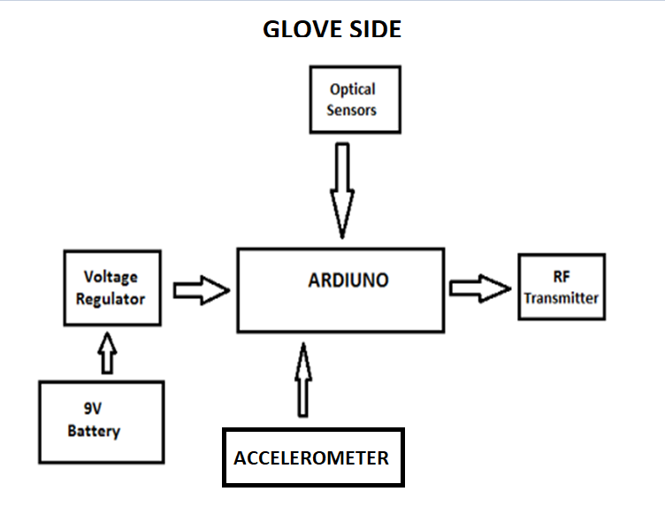
Gesture Recognition
Circuit Diagram
Algorithm
Program

Slide 11
Gesture Interpretation
The data received at Arduino is in the form of characters i.e. A, B, C, D, E and 1, 2, 3, 4, 5.
Where on receiving alphabetical characters loads will be controlled while on receiving numeric characters messages will be sent.
CIRCUIT DIAGRAM
Algorithm
Program

Slide 12
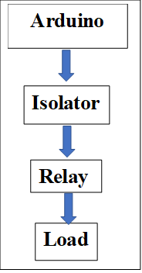
Appliance Control
The loads will switch on switching of relay by means of Arduino.
Hardware components

Slide 13
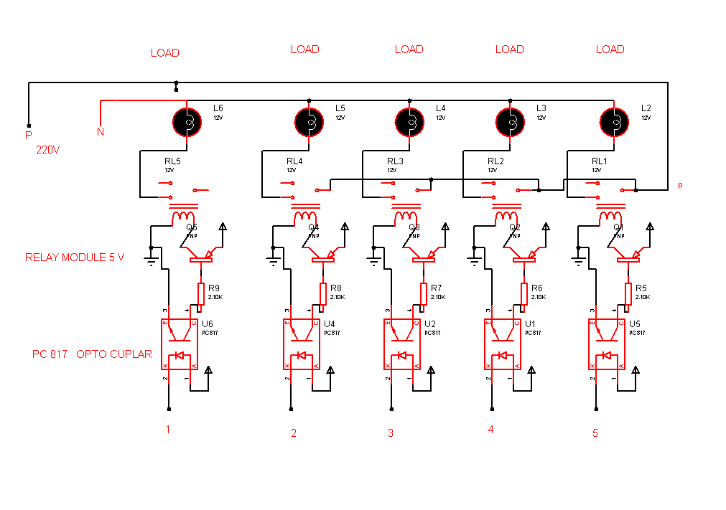
Appliance Control

Slide 14
Utilization of Project Results
Physically Disabled persons
Speech disabled persons
Hospitals.
Old Homes.
Pharmaceutical Industries.

Slide 15
References
[1] P.B.Patel¹, Suchita Dhuppe², Vaishnavi Dhayev “Smart Glove For Deaf And Dumb Patient”.Department Of Instrumentation Engineering Dr. D. Y. Patil Institute Of Technology Pimpri , Pune 411018 Maharashtra India.
[2] Solanki Krunal, “Microcontroller Based Sign Language Glove” International Journal for
Scientific Research & Development (IJSRD),Vol.1,Issue 4, 2013, pp.831-833.
[3] Tushar, Ankit, Anvesh and S. M. Sameer “Smart Glove With Gesture Recognition Ability For The

Slide 16
References
Hearing And Speech Impaired”. 2014 IEEE Global Humanitarian Technology Conference - South Asia Satellite (GHTC-SAS) | September 26-27, 2014 | Trivandrum
[4] Darshan,Malad,Mousumi,Nilesh, Akshay,Mohan “Hand Gesture Recognition and Voice Conversion System for Speech Impaired” International Research Journal of Engineering and Technology (IRJET).2017.
[5] Dhawal L. Patel1, “ Smart Hand Glove For Disable People” International Research Journal of Engineering and Technology (IRJET) e-ISSN: 2395- 0056, Volume: 05 Issue: 04 | Apr-2018 04.

Slide 17


